Slide 1
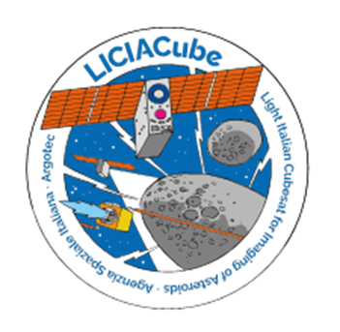
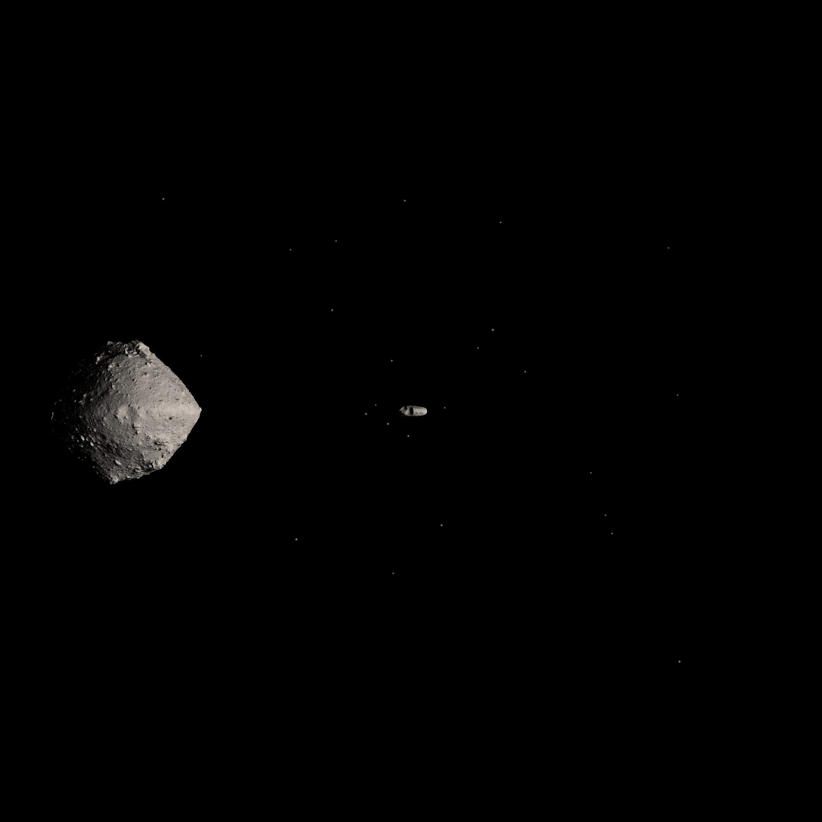
LICIACube images archived at SSDC will boost science
SSDC will archive and manage LICIACube images.
Images will be calibrated soon after the download.
Data will be made immediately available to the team.
9 months after the impact the data will be public.
The archive design could help in using data with MATISSE tool.
MATISSE is the SSDC webtool for the planetary exploration data (https://tools.ssdc.asi.it/Matisse).
It allows to visualize data directly on the 3D shape model of the target object (valuable for irregular objects such as small asteroids).
Up to now it is possible to search for geological features and to run surface models on MATISSE
New features will be added to better analyze LICIACube data.
LICIACube will acquire images soon after DART impact with Dimorphos: the data archived at SSDC will be preserved and made available also in the future and, by means of the tool MATISSE, valuable science can be achieved.
Zinzi, A., et al. (2022) Planetary Science Journal, https://doi.org/10.3847/PSJ/ac6509

