Slide 1
SPACE SLIME
www.asi.it
07-10-2021

Slide 2
Introduction
Full Title: Space Slime
ESA technical project manager: TBD
Scientific Team Coordinator: TBD
ESA Project Scientist: TBD
ASI PM: Galoforo Germana
PI: Marta Del Bianco
PD: TBD
Hypothesis
EDUCATIONAL PROJECT

Slide 3
Objectives
Educational: High-schoolers (3rd-4th year) will perform their own preliminary tests by growing the slime mould Physarum polycephalus in simulated microgravity and under mechanical stress. To do this, they will have to learn how to handle the slime mould and construct their own clinostat and/or vibrating plates. Children will then generate hypotheses on the behaviour of the slime mould in microgravity and test them against the inflight experiments upon retrival.
Teach pupils the bases of the scientific method (observation, hypotheses, test)
Engage school children with STEM and engineering
Scientific: P. polycephalus is a well established model system for fundamental research on single cell spatial intelligence and orienteering.
Study the behaviour of slime mould in microgravity
Study the molecular bases of cell proprioception

Slide 4
Operational Overview
2021
2022
2023
OCT
NOV
DEC
JAN
FEB
MAR
APR
MAY
JUN
JUL
AUG
SEP
OCT
NOV
DEC
JAN
FEB
SELECTION
CONTRACT
PREP EDUCATIONAL MATERIAL
SCHOOL EVENTS
SCHOOL EVENTS
HW DEVELOPMENT AND QUALIFICATION
FLIGHT
PREPARATORY EXPERIMENTS AND SCIENTIFIC SUPPORT
POST-FLIGHT ANALYSES
Dates are still TBD and will depend on HW development and flight availability.

Slide 5
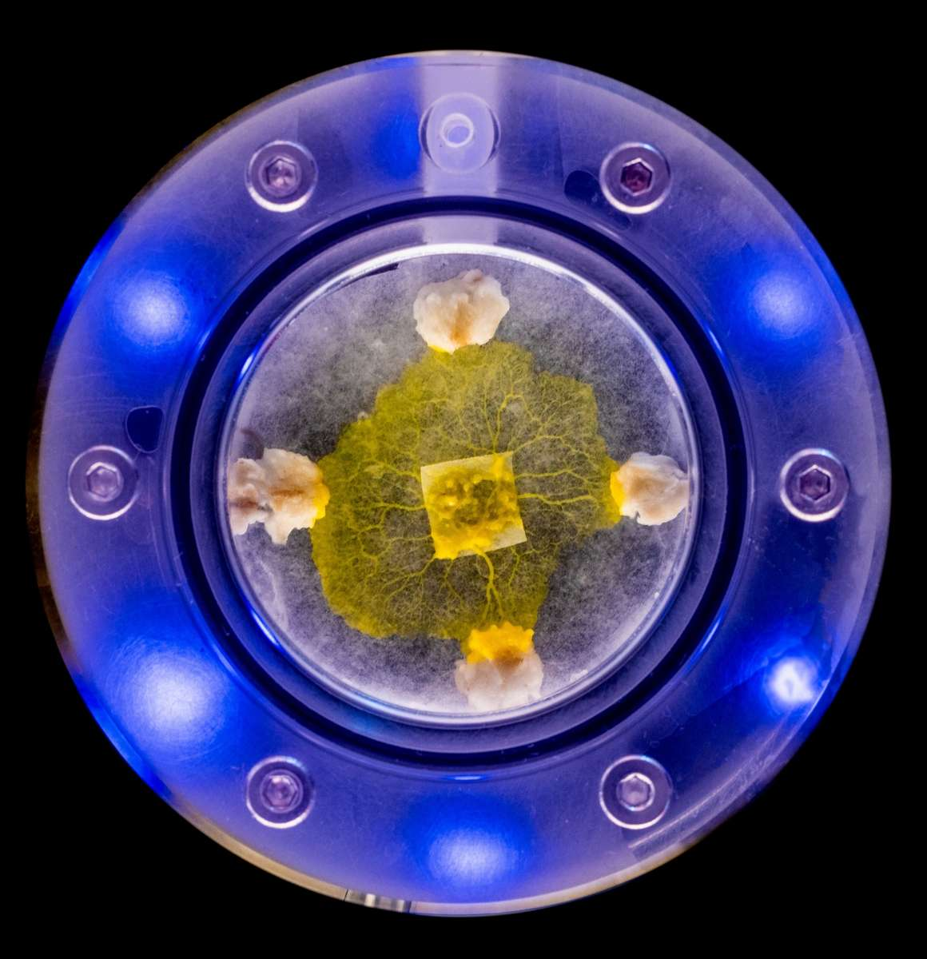
Hardware Requirements
Plates containing dormant (dehydrated) slime mould (P. polycephalum) will be uploaded to the ISS. Slime mould does not require temperature control or gas exchange, the hardware will be completely automated and self-contained. Technical requirements will be set by the SME that will develop the HW.
After activation (addition of water), the experiment runs for 2-4 days: the slime moulds would be let to grow and imaged regularly. Image download, at least partial, would be preferable for experiment monitoring.
The experiment is stopped by fixation (RNAlater). Fixed samples are stable at 4°C, but lower temperatures would be preferable.
CNES/ESA

Slide 6
Requirements
For school activity phase:
In flight: - message from astronauts (if possible)
For payload phase:
Upload: - up-mass TBD
- NO temperature control requirements (RT required)
- late access (if possible)
In flight: - minimal handling
- power supply (if possible)
- data download (if possible)
- NO temperature control before and during experiment (RT required)
- 4°C stowage after fixation (or lower, if possible)
Download: - down-mass: same as up-mass, TBD
- 4°C stowage (or lower, if possible)
- early retrieval

